Slide 1

Session 1: Automating Grading & Scheduling Lesson 1: Auto-Grading with Google Forms & Flubaroo
Module 2: Automating Administrative Tasks
Objective: Automate quizzes and instant feedback using Google Forms and Flubaroo. Activities

Slide 2
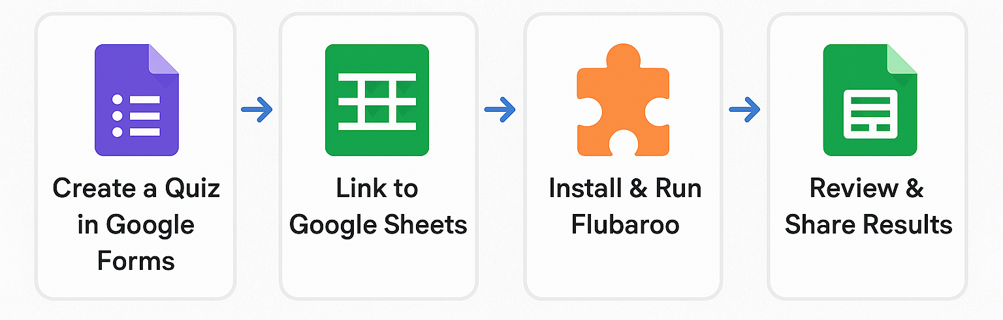
Automating Assessment in AI Teaching
Objective: Streamline quizzes and assessments in AI-related courses using free tools.
Tools:
Google Forms – Create quizzes with auto-grading support
Google Sheets – Collect and organize responses
Flubaroo Add-on – Grade quizzes, email results, and analyze performance
Workflow:

Slide 3
Automating Assessment in AI Teaching
Benefits:
Time-saving automation
Real-time analytics
Encourages continuous improvement
Scalable for large AI classes
Activity:
Create a question quiz in Google Forms.
Link responses to Google Sheets.
Install Flubaroo and run auto-grading.
Email feedback to peers.
Group discussion

Slide 4
Session 1: Automating Grading & Scheduling Lesson 2: Efficient Feedback with Gradescope
Module 2: Automating Administrative Tasks
Objective: Use AI-assisted tools for grading scanned or handwritten assignments. Activities

Slide 5
Enhancing AI Education with Gradescope Gradescope is an AI-powered online grading and assessment platform designed to streamline grading for educators while providing detailed feedback to students.
Objective: Use Gradescope to efficiently grade AI coursework, from coding assignments to math-heavy derivations — while providing meaningful, scalable feedback.
What is Gradescope? An AI-assisted grading platform designed for:
Handwritten, typed, or code-based assignments
Auto-grouping of similar answers
Dynamic rubrics and feedback reuse
How It Helps You as an Instructor:
Faster Grading: Use AI to cluster similar answers and apply bulk feedback
Rubric-Based Evaluation: Adjust scores dynamically, even after grading
Reusable Comments: Save and reuse detailed feedback
Analytics: Spot weak areas and identify learning trends
Supports Integration: Compatible with LMS (e.g., Canvas, Moodle)Workflow:
Notes:
It’s widely used in higher education (e.g., universities) but also supports K-12. Unlike Flubaroo (which works with Google Forms), Gradescope handles handwritten work, code, bubble sheets, and typed answers with advanced AI-assisted grading features.

Slide 6
Enhancing AI Education with Gradescope
Activity:
Upload a sample PDF of student work.
Define answer regions and use AI grouping for similar responses.
Provide feedback and release grades.
Peer reflection

Slide 7
Session 1: Automating Grading & Scheduling Lesson 3: Weekly Planning with Trello
Module 2: Automating Administrative Tasks
Objective: Use a visual board to manage lesson plans and timelines. Activities

Slide 8
Trello Workflow in AI Course Management Trello is a visual project management and collaboration tool that uses cards, lists, and boards to organize tasks and workflows. It’s based on the Kanban method (a popular Agile framework) and is used by individuals, teams, and businesses for everything from simple to-do lists to complex project tracking.
Objective: To organize course management, track student progress, and coordinate with TAs and team members efficiently in AI courses through a visual, collaborative task management system.
What is Trello? Popular project management and collaboration tool often used in teaching and learning environments — including those involving AI.
Organizing Course Content & Assignments:
Teachers can create boards for courses, with lists and cards representing modules, lessons, assignments, or projects. This helps keep everything structured and trackable.
Collaborative Learning:
Students and instructors can collaborate on projects or group assignments using Trello boards. AI-related projects especially benefit from this because multiple team members can track tasks, share resources, and update progress.
AI-Enhanced Features:
While Trello itself isn’t an AI tool, it can integrate with AI-powered apps and automation (like Butler for Trello) to automate repetitive tasks, set reminders, or manage workflows smartly.
Tracking Student Progress:
Teachers can use Trello boards to monitor individual or group progress in AI courses, research projects, or lab work.

Slide 9
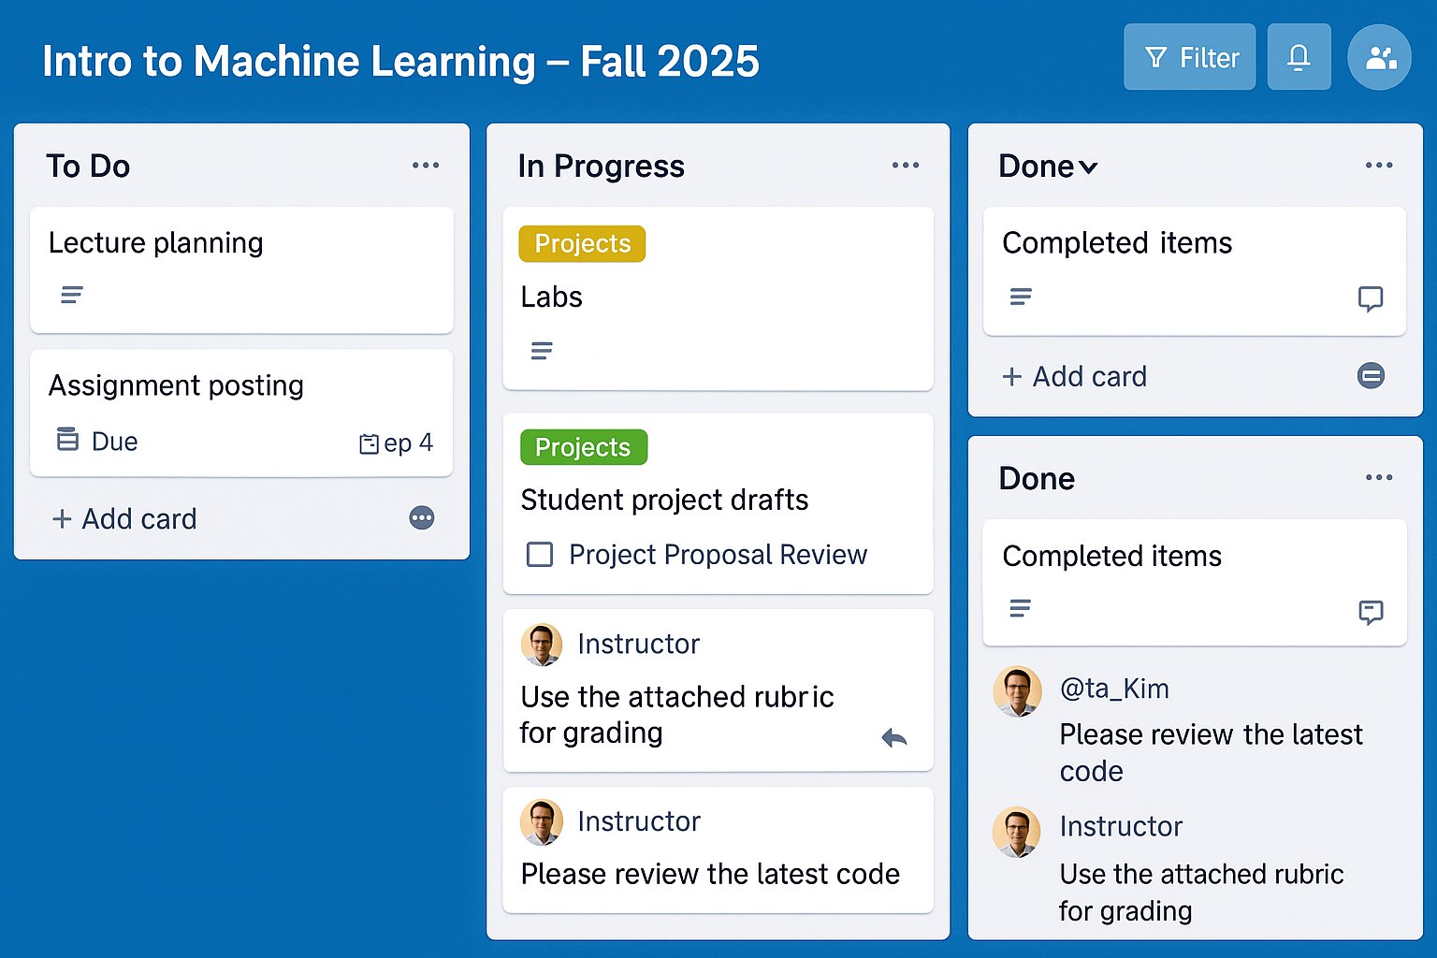
Trello Workflow in AI Course Management
Activity:
Set up a Trello board for a 2-week teaching unit.
Add lists (e.g., To Do, In Progress, Done) and cards for each task.
Add deadlines, checklists, and collaborators.
Share boards with the group and offer feedback.

Slide 10
Session 1: Automating Grading & Scheduling Lesson 4: Smart Planning with Notion AI
Module 2: Automating Administrative Tasks
Objective: Leverage AI support to create content, summaries, and rubrics.
Activities

Slide 11
Enhancing Teaching with Notion AI Notion AI is a built-in AI assistant in Notion that helps educators write, organize, and manage content faster, enabling better teaching and learning experiences.
Objective: To streamline teaching workflows, personalize learning, and reduce administrative burden by using Notion AI in course delivery and management across any subject area.
Benefits
Time Efficiency
Saves hours on prep and content creation
Content Quality
Enhances clarity, tone, and structure
Student Engagement
Offers clear, concise, AI-simplified content
Accessibility
Adapts content for diverse learners
Innovation
Models real-world AI tools in use

Slide 12
Enhancing Teaching with Notion AI
Activity:
Create a Notion page titled “Lesson Plan – Week 1.”
Use AI prompts to generate a rubric or lesson summary.
Customize and present to peers.
Prompt example

